Slide 1
ATAI
Advanced Techniqueof Artificial Intelligence
ATAI
ChongqingUniversity _{AdvancedTechniqueof}
of Technology Artificial Intelligence
Chongqing University of
Technology
Chongqing University ^{ATAI}
_{of Technology} Advanced Techniqueof
Artificial Intelligence
Chongqing University of Technology
Chongqing University of Technology
Dynamic Integration of Task-Specific Adapters for Class Incremental Learning
Code:None
2025.6.25 •ChongQing
—— CVPR_2025
Reported by Lele Ren
1

Slide 2
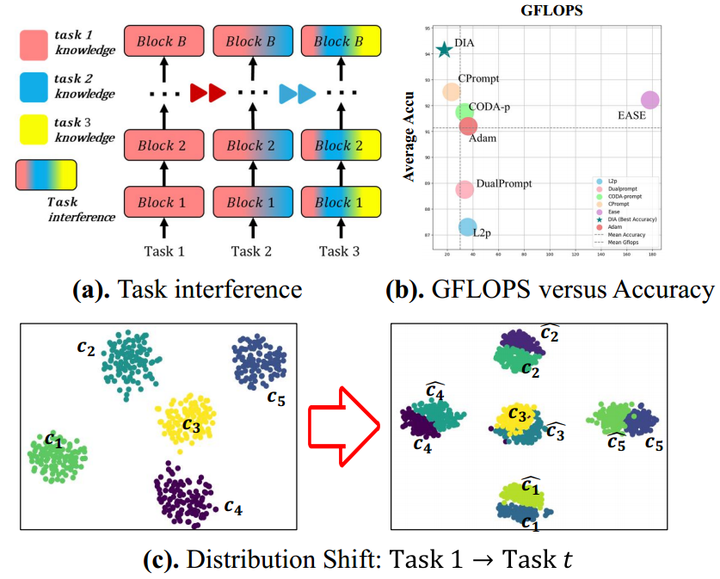
ATAI
AdvancedTechniqueof
Artificial Intelligence
ATAI
ChongqingUniversity _{AdvancedTechniqueof}
of Technology Artificial Intelligence
ChongqingUniversity of Technology
Motivation
1.Compositionality Deficiency: Many existing methods learn new tasks through shared parameter spaces or task-specific prompts, but these approaches often lead to parameter mixing between tasks, causing task interference and catastrophic forgetting.
2.Model Alignment Deficiency: Existing prototype-based feature reconstruction methods generate pseudo-features that increasingly deviate from the true distribution, failing to effectively align classifier boundaries.

Slide 3
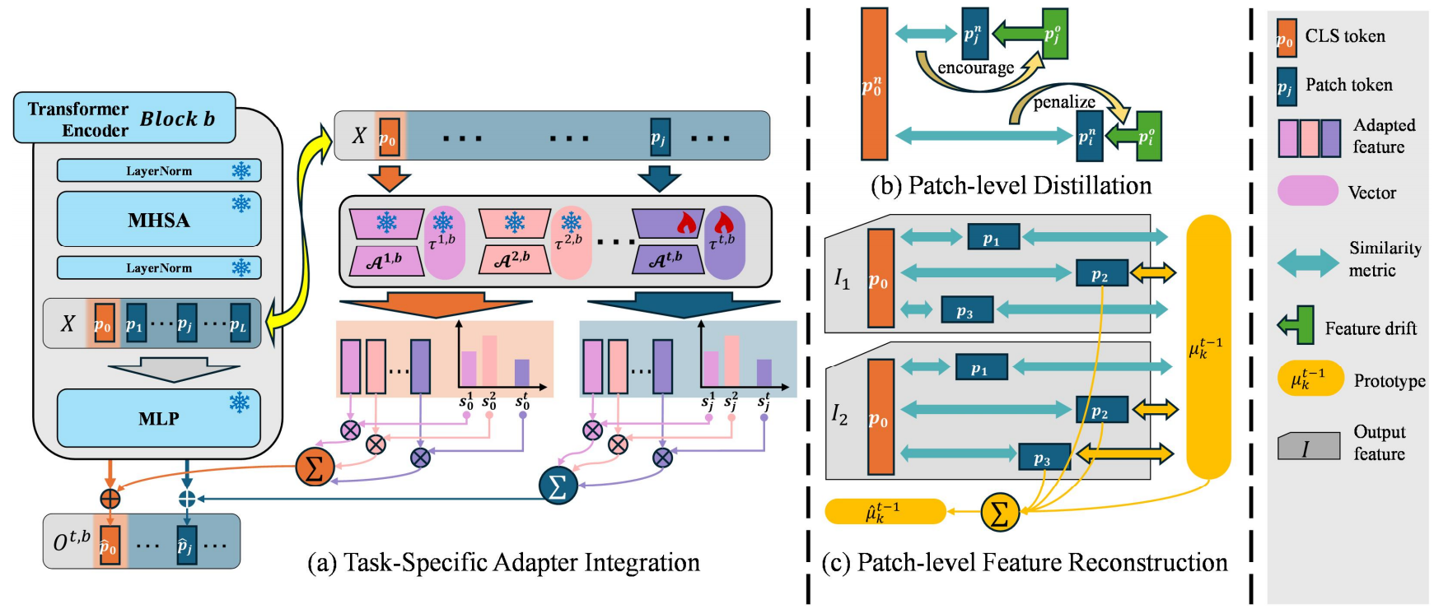
ChongqingUniversity of Technology
ATAI
AdvancedTechniqueof
Artificial Intelligence
ATAI
ChongqingUniversity _{AdvancedTechniqueof}
of Technology Artificial Intelligence
Overview

Slide 4
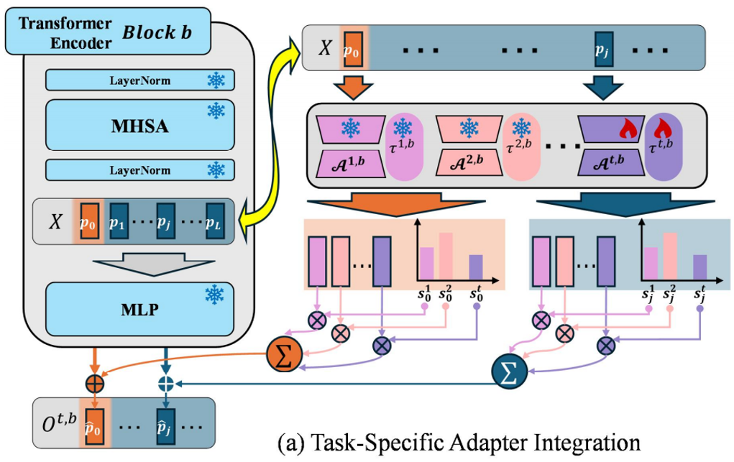
ChongqingUniversity of Technology
ATAI
AdvancedTechniqueof
Artificial Intelligence
ATAI
ChongqingUniversity _{AdvancedTechniqueof}
of Technology Artificial Intelligence
Method

Slide 5
ChongqingUniversity of Technology
ATAI
AdvancedTechniqueof
Artificial Intelligence
ATAI
ChongqingUniversity _{AdvancedTechniqueof}
of Technology Artificial Intelligence
Method

Slide 6
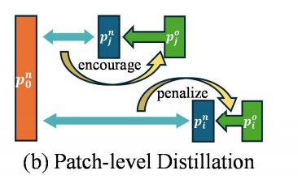
ChongqingUniversity of Technology
ATAI
AdvancedTechniqueof
Artificial Intelligence
ATAI
ChongqingUniversity _{AdvancedTechniqueof}
of Technology Artificial Intelligence
Method

Slide 7
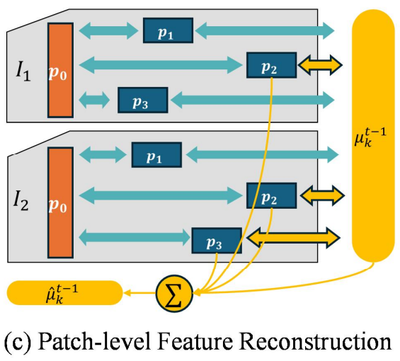
ChongqingUniversity of Technology
ATAI
AdvancedTechniqueof
Artificial Intelligence
ATAI
ChongqingUniversity _{AdvancedTechniqueof}
of Technology Artificial Intelligence
Method

Slide 8
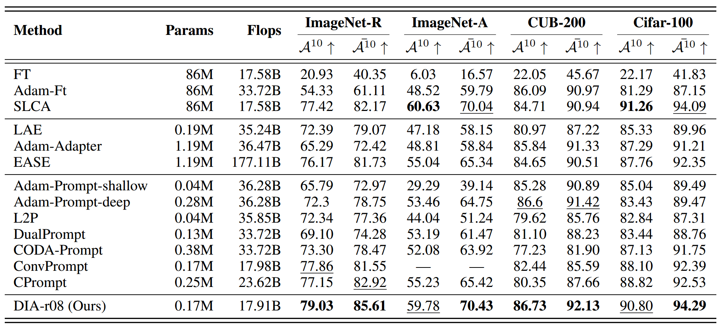
ATAI
AdvancedTechniqueof
Artificial Intelligence
ATAI
ChongqingUniversity _{AdvancedTechniqueof}
of Technology Artificial Intelligence
ChongqingUniversity of Technology
Experiments

Slide 9
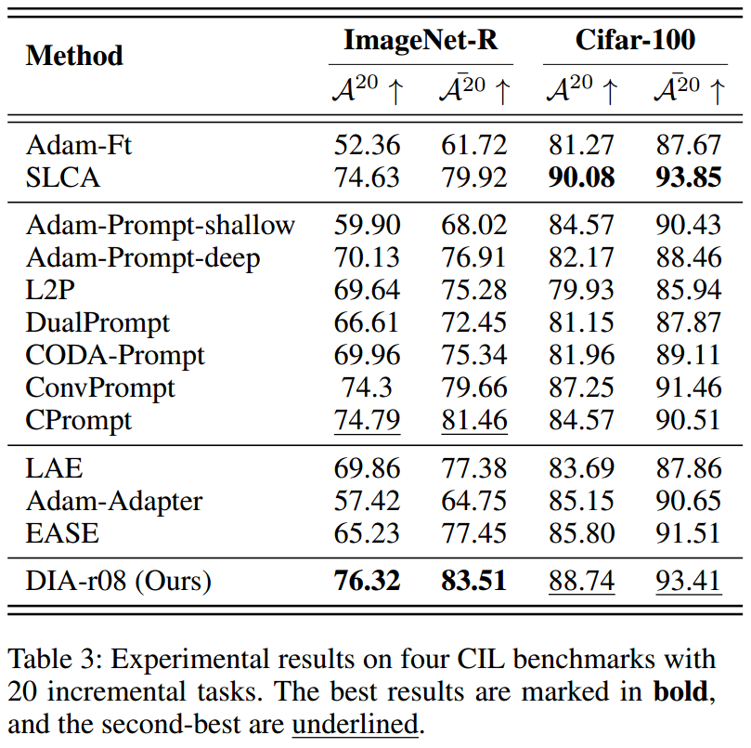
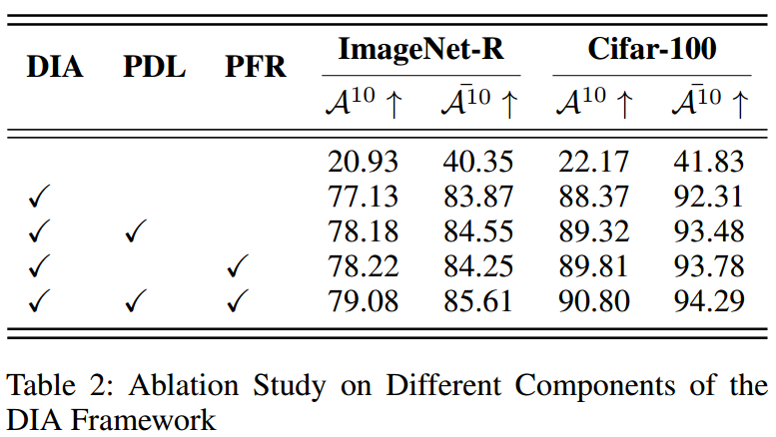
ATAI
AdvancedTechniqueof
Artificial Intelligence
ATAI
ChongqingUniversity _{AdvancedTechniqueof}
of Technology Artificial Intelligence
ChongqingUniversity of Technology
Experiments

Slide 10
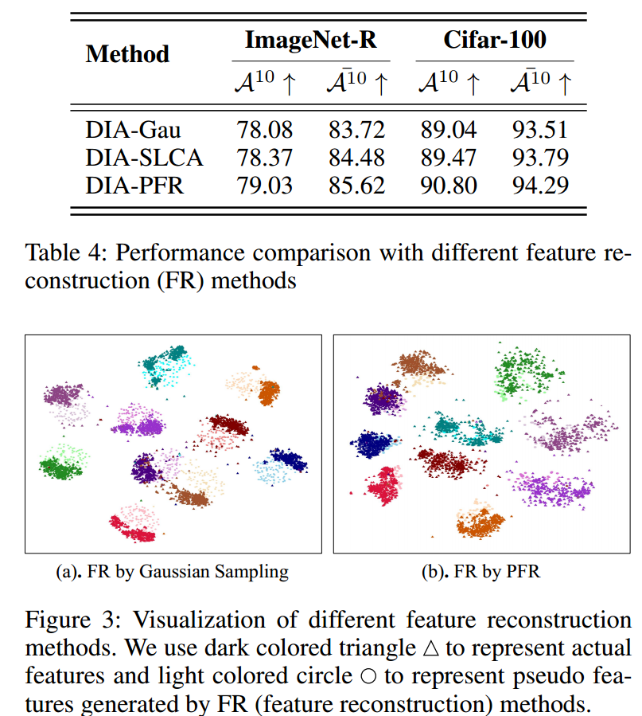
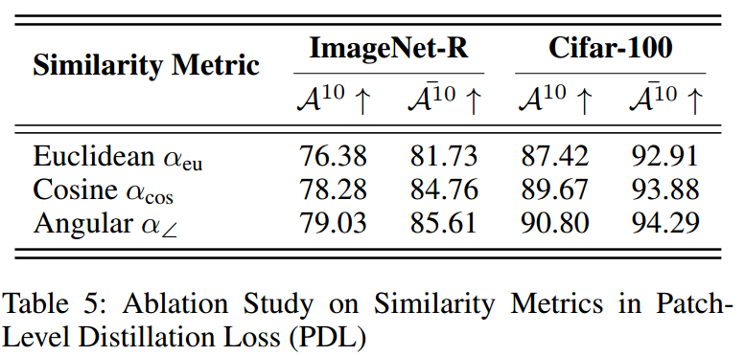
ATAI
AdvancedTechniqueof
Artificial Intelligence
ATAI
ChongqingUniversity _{AdvancedTechniqueof}
of Technology Artificial Intelligence
ChongqingUniversity of Technology
Experiments

Slide 11
ChongqingUniversity of Technology
ATAI
AdvancedTechniqueof
Artificial Intelligence
ATAI
ChongqingUniversity _{AdvancedTechniqueof}
of Technology Artificial Intelligence
Thanks!

